Slide 1
NE 591: Advanced Reactor Materials
Fall 2021
Dr. Benjamin Beeler

Slide 2
Last Time
Completed FCCI for metallic fuels
highlighted different compositions, and which species participate
Ce and Nd are primary FPs that diffuse into the cladding
Fe and Ni diffuse into the fuel
melting experiments to test irradiated fuel
Metal Fuel Fabrication
injection casting process

Slide 3
Reprocessing
Pyroprocessing
For more than 50 years, pyrometallurgy has been studied as an alternative strategy in the reprocessing of used fuel
Pyrochemical processes rely on refining techniques at high temperature (500–900 C) depending on the molten salt eutectic used
Typically, chloride systems operate at lower temperature compared to fluoride systems, and are preferred in processing
These processes are mainly based on electrorefining or on extraction from the molten salt phase into liquid metal
Two processes-one for oxide fuel and one for metallic fuel-have been developed to near industrial scale

Slide 4
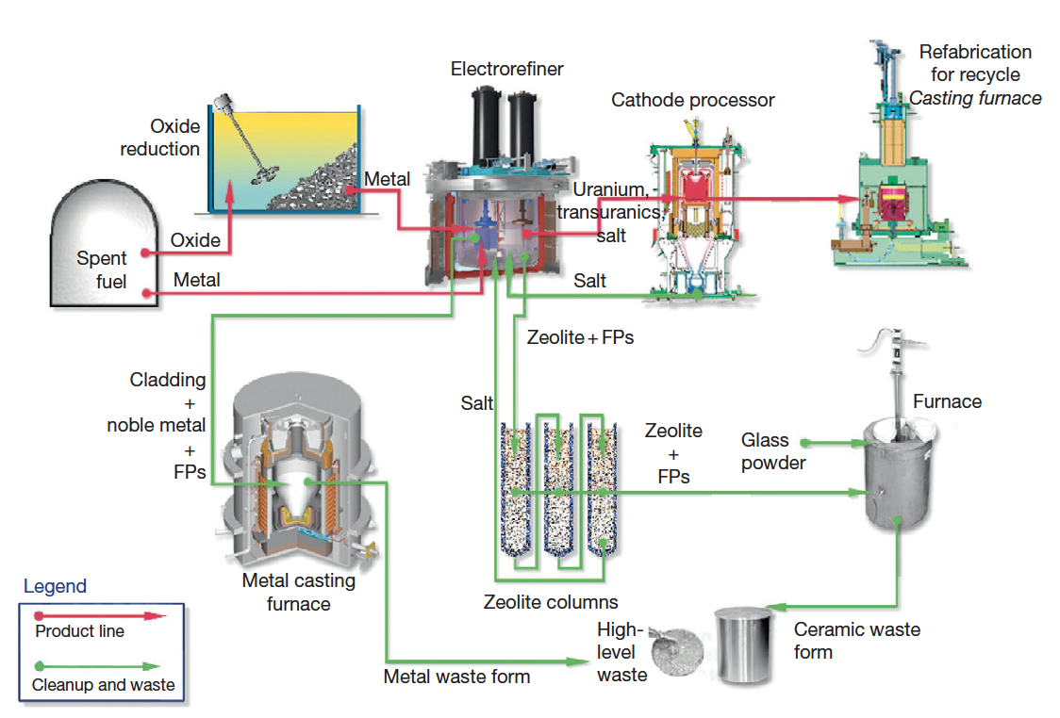
IFR Pyroprocess
This process was developed in the US to be part of the IFR project, and can handle the treatment of transuranics
The fuel is recycled using an electrochemical process based on molten chloride salts and liquid metals
The molten salt medium for electrorefining is a solution of a certain amount of UCl3 dissolved in a LiCl–KCl eutectic

Slide 5
IFR Pyroprocess
The fuel is electrochemically dissolved using a potential between the basket (loaded with used fuel) as anode and a stainless steel electrode in the salt as the cathode
Uranium and TRU are deposited on the cathodes
Once the fuel is dissolved and most of the uranium is deposited on the solid steel, this cathode is replaced by a liquid cadmium cathode, and the remaining TRUs can be co-deposited with the remaining uranium

Slide 6
IFR Pyroprocess
The alkali, alkaline earth, rare earth, and halide FPs remain primarily dissolved in the salt phase
More than 90% of the noble metal FPs and fuel alloy material are retained in the chopped fuel cladding segments in the anode baskets
Can reduce the repository burden of radioactive waste by separating long-lived MA from spent light-water reactor fuel, burning MA in fast reactors, and decreasing the long-term radioactivity of nuclear waste

Slide 7
Refabrication
Metal-fueled fast reactors facilitate the effective transmutation of MA because of the high-energy neutron spectrum
One of the measures to load MA into the reactor core is to add MA to the fuel alloy homogeneously
Can perform injection casting in the same manner as the fresh fuel, to form MA-bearing fuel alloys
These technologies are expected to reduce the fuel cycle cost even for small-scale fuel cycle plants because of the simplicity of the process and the compactness of the equipment
For example, in the injection casting process, composition adjustment, melting (alloying), and casting of the fuel slug can be done in a single injection-casting furnace

Slide 8
Metallic fuel performance modeling

Slide 9
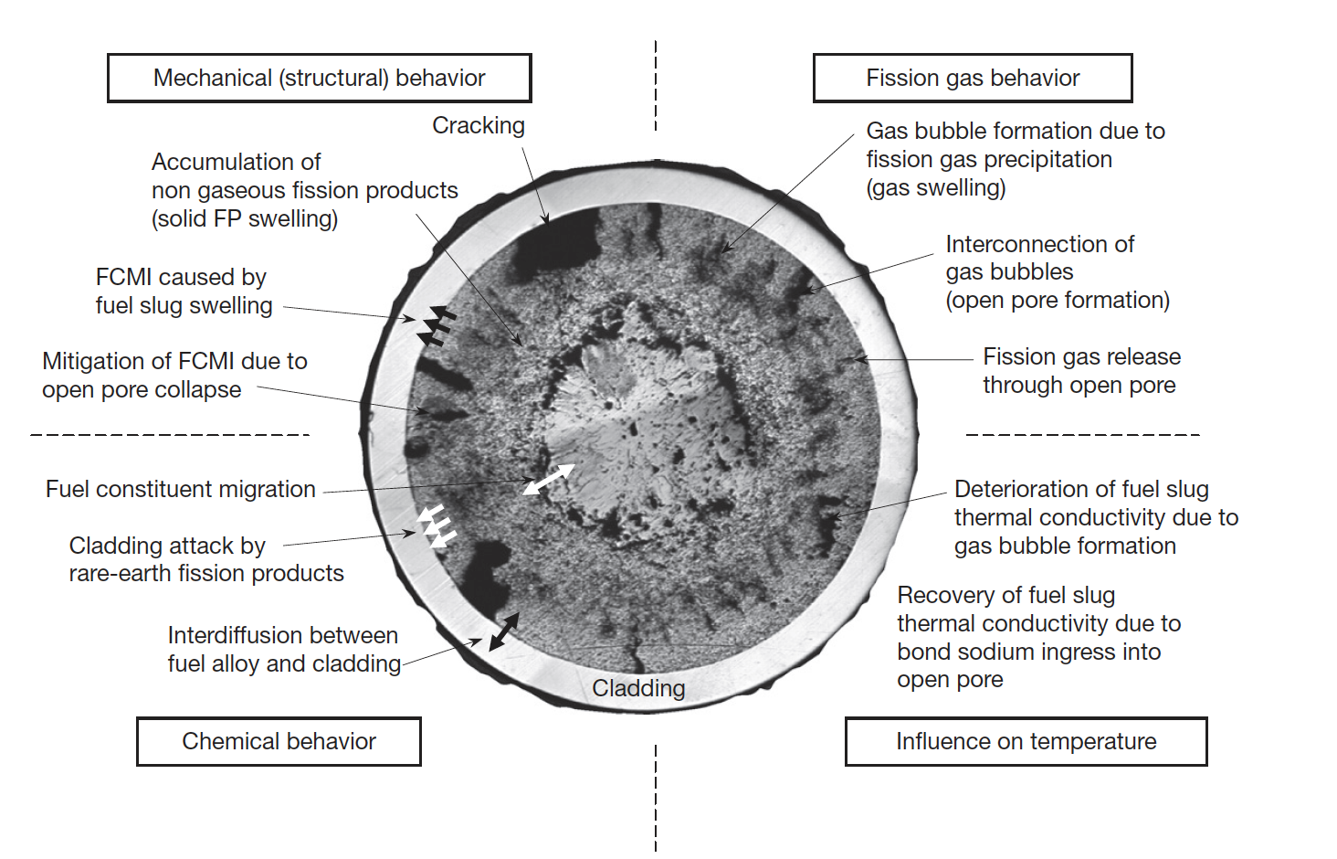
Metallic Fuel Phenomena

Slide 10
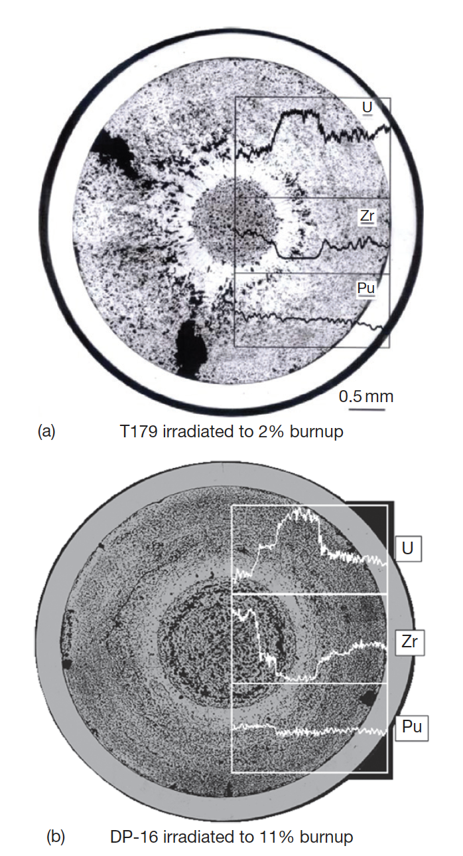
Constituent Redistribution Models
Constituent redistribution is driven by:
temperature gradients in the fuel,
solubility gradients in a phase and phase boundaries,
additional chemical potentials applied by fuel– cladding gap and cladding
Results in three concentric zones, namely, a Zr-enriched central zone, a Zr-depleted and U-enriched intermediate zone, and a slightly Zr-enriched zone on the outer periphery
Migration quickly levels off early in life after a new distribution settles

Slide 11
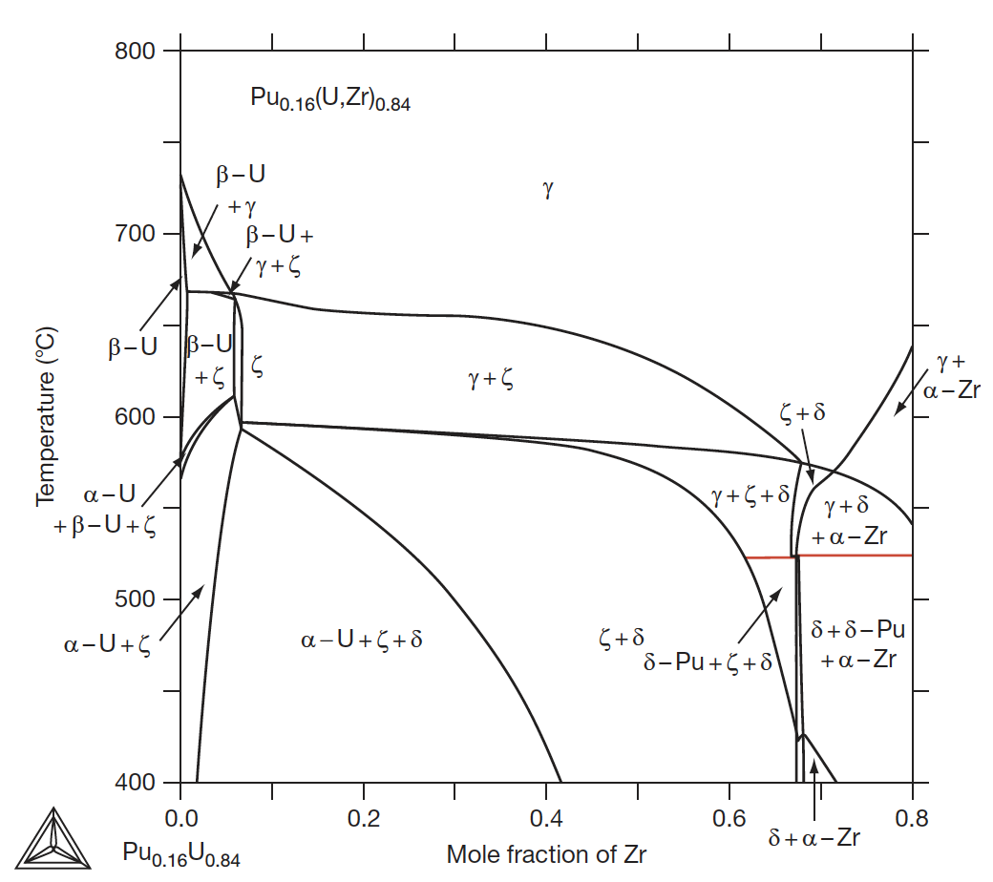
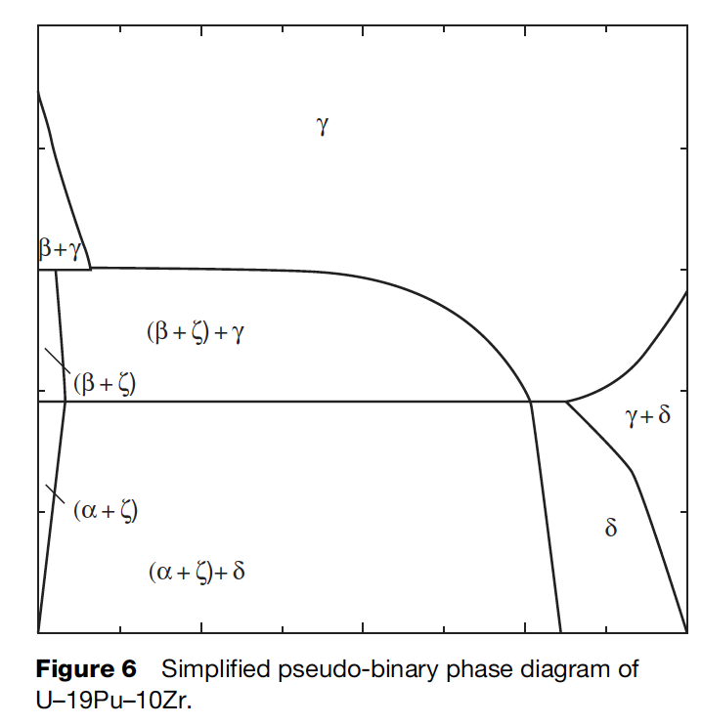
Constituent Redistribution Models
While ternary phase diagrams exist, their accuracy is suspect, and simplified pseudo-binary phase diagrams can be more easily implemented, and removes complexities associated with largely unknown phases
When applied to a fuel with different Pu content, the phase diagram must be modified accordingly

Slide 12
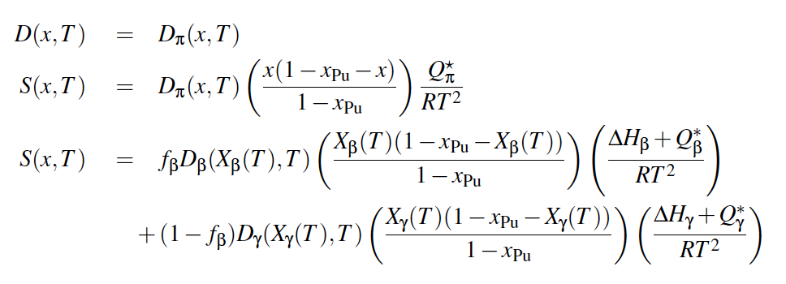
Constituent Redistribution Models
Using the calculated phase fractions, the Fickian and Soret diffusion coefficient are determined
Artificial factors are used to set the diffusivity in two-phase regions and to scale diffusivities in each phase
The magnitudes of diffusivities in each phase are largely unknown, and effectively wholly unknown in two-phase regions
BISON Zr Diffusion Model

Slide 13
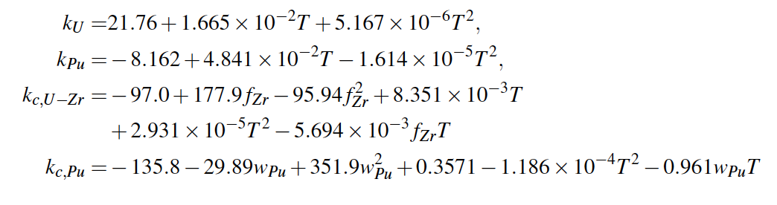
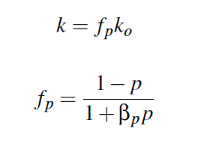
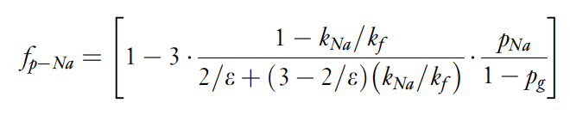
Temperature Predictions
Constituent redistribution relies on accurate temperature profiles
Fuel temperature is affected by the thermal conductivity of the fuel, which in turn is changed by porosity evolution and sodium infiltration, in addition to changes in Zr concentration
BISON thermal conductivity models exist for the distinct phases/species, and account for degradation of thermal conductivity

Slide 14
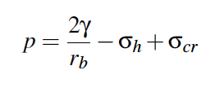
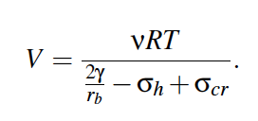
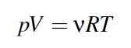
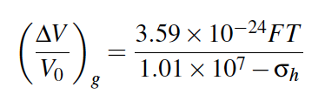
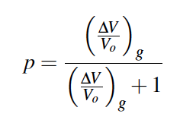
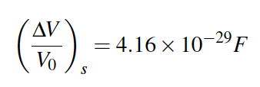
Porosity Predictions
BISON utilizes a simplified model for porosity
The mechanical force balance on an equilibrium bubble can be expressed by the Young-Laplace equation
Making assumptions for creep stress, bubble size, can calculate swelling due to fission gas
Finally, can determine porosity from the swelling
Solid fission products are a function of fission density

Slide 15
Porosity Predictions
These porosity models don’t incorporate different phases, initial porosity, axial/radial swelling, etc.
These models have been updated slightly to improve code robustness, but still don’t incorporate these critical microstructural phenomena

Slide 16
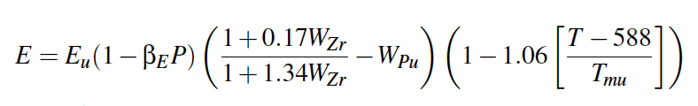
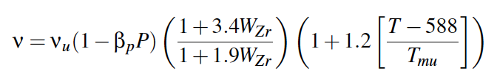
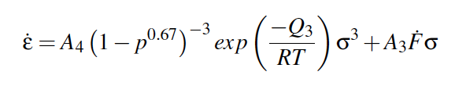
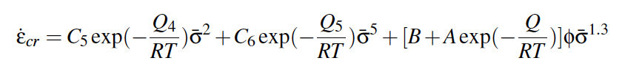
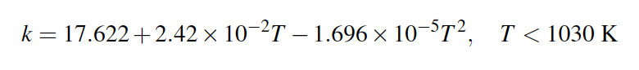
Mechanical Properties
Young’s Modulus
Poisson’s ratio
Creep
Cladding models for HT-9 creep and k_{th}

Slide 17
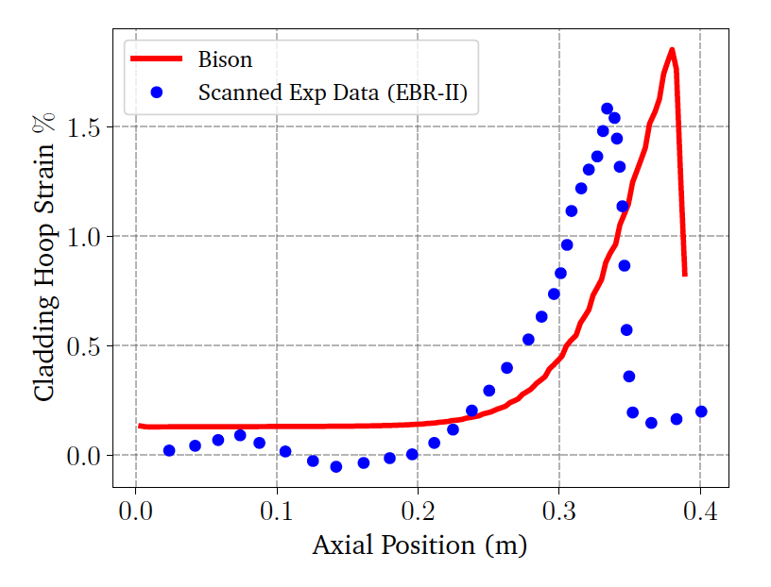
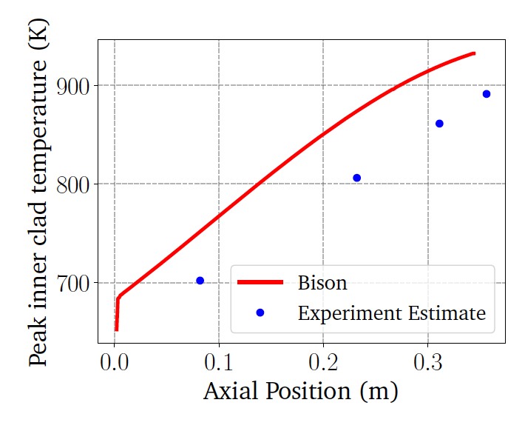
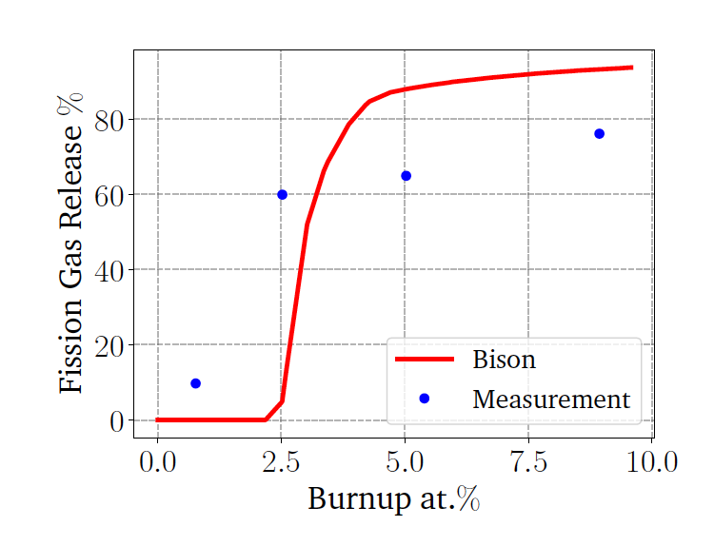
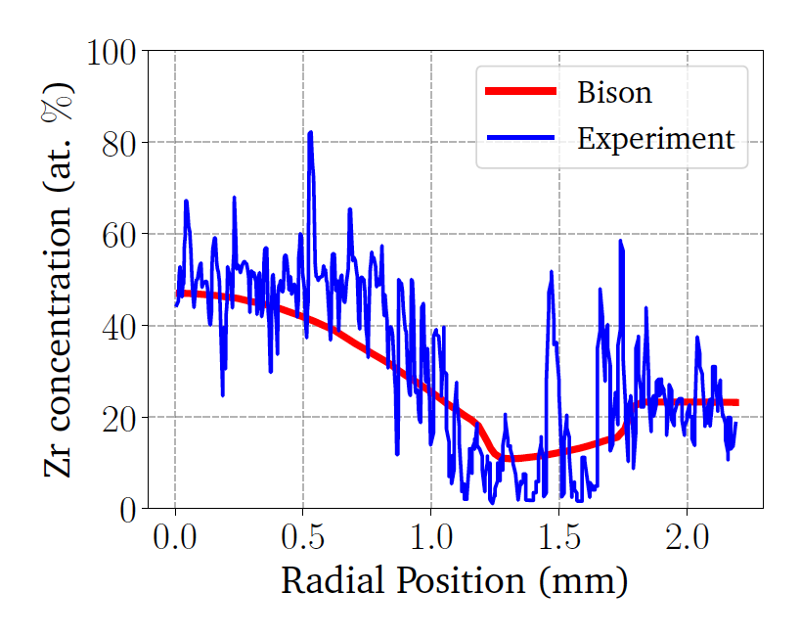
BISON Testing
BISON can handle binary and ternary fuel and compare reasonably well with EBR-II data
Discrepancies are due to inadequate knowledge of materials models, and underlying issues with material descriptions, and code robustness
Development is ongoing, and improvements to swelling models, for example, have been made

Slide 18
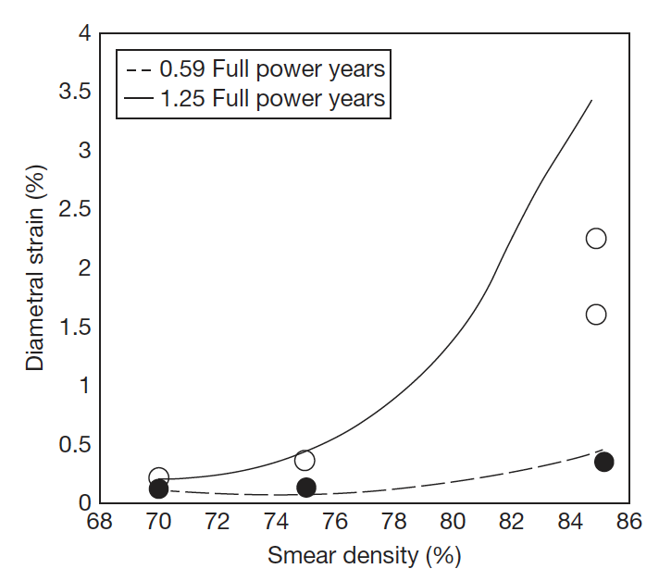
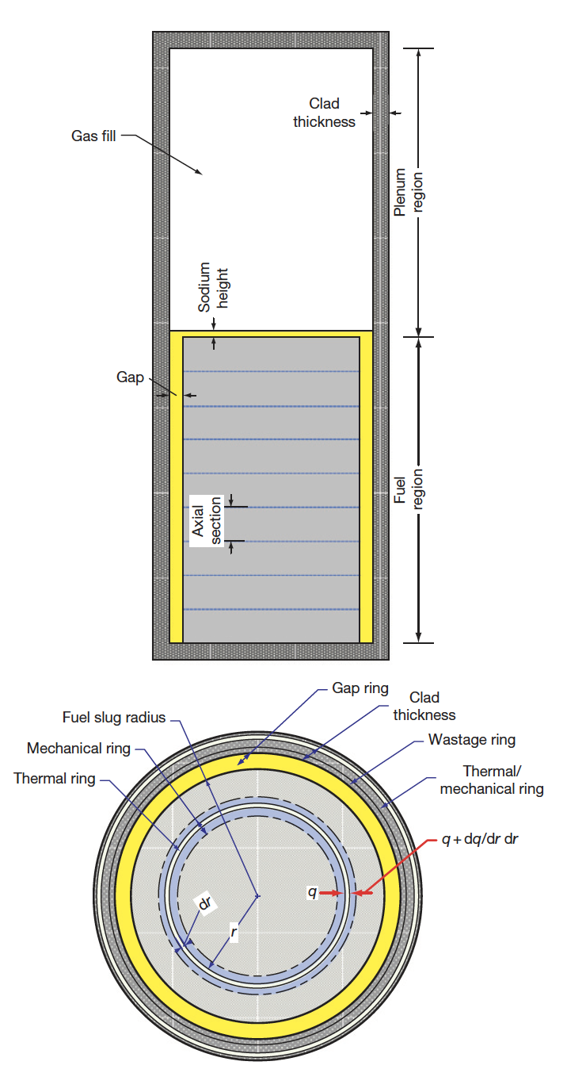
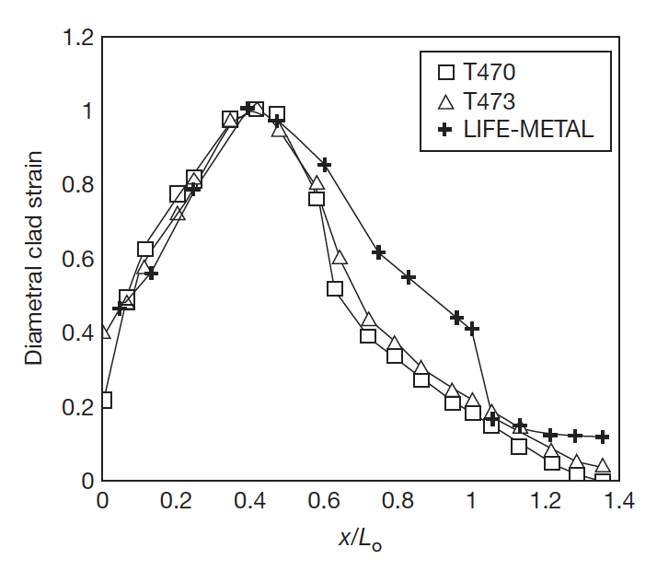
Other Codes
LIFEMETAL
The code has evolved from the LIFE series of codes from ANL that perform steady-state and transient analyses for nuclear fuel
The original code was developed for UO2 and mixed oxide fuels for use in fast reactor systems
The code was developed in association with the IFR and has been extensively used for planning steady state and transient experiments at EBR-II

Slide 19
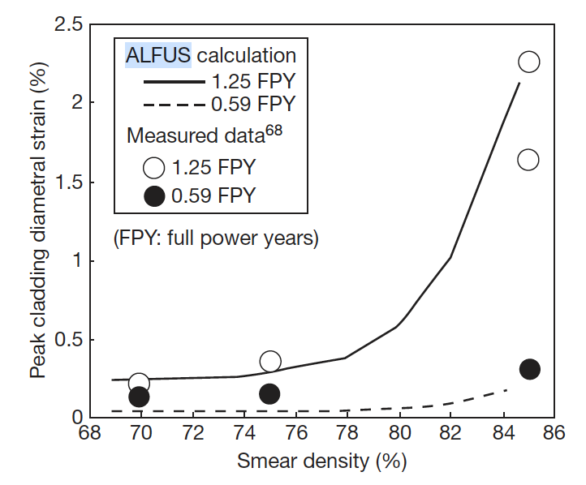
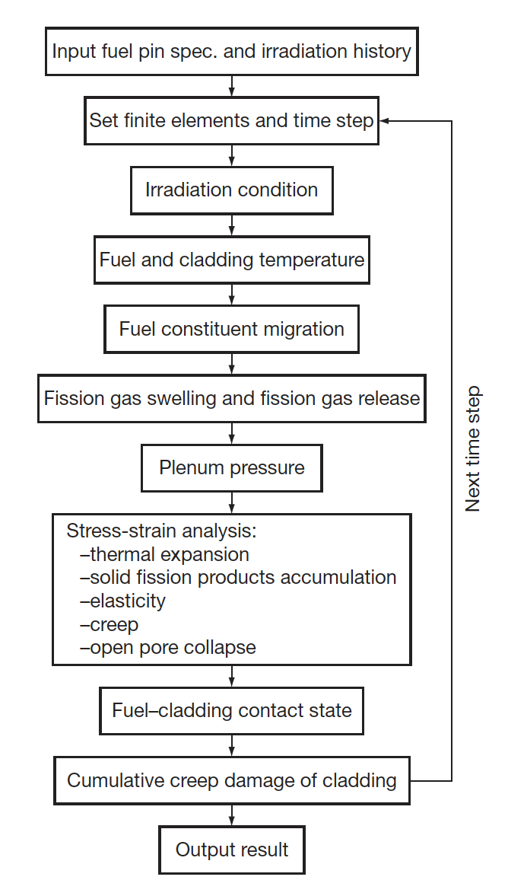
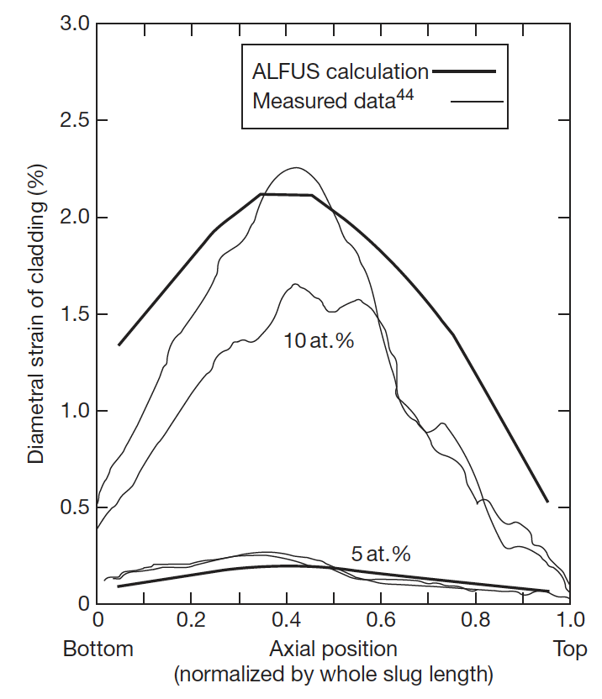
Other Codes
ALFUS
JAEA code that is multiphysics in nature and focuses on the mechanical behavior of the fuel under irradiation
Both LIFE-METAL and ALFUS are capable of simulating metal fuel irradiation behavior to some extent
Both lack different swelling in different radial zone, coupling of redistribution, realistic predictions of FCCI

Slide 20
Mixed oxide fuel

Slide 21
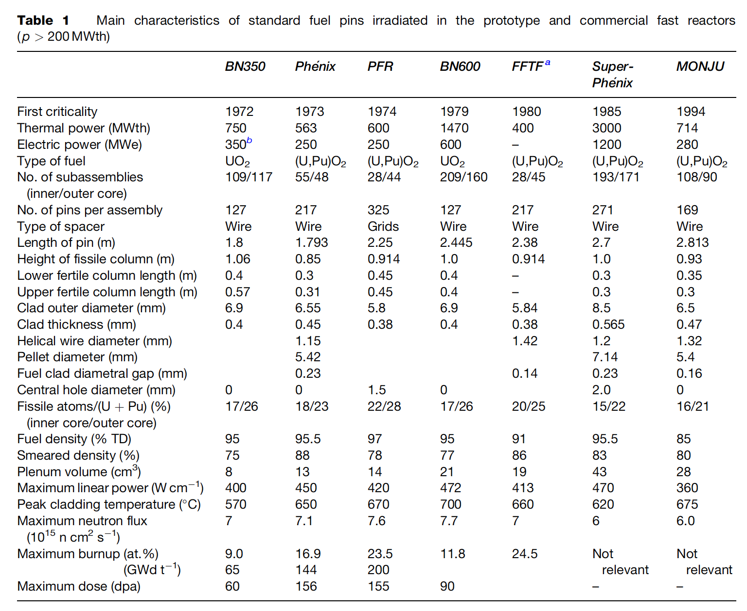
MOX Introduction
Despite some disadvantages, such as its low U density, poor thermal conductivity, and its chemical reaction with sodium, MOX fuel (U,Pu)O2 is the fuel that has been used most in fast reactors
In order to avoid the dramatic swelling of metallic fuels, MOX fuels were explored in fast reactors
Behavior was observed to be satisfactory and was relatively widely implemented in SFRs

Slide 22
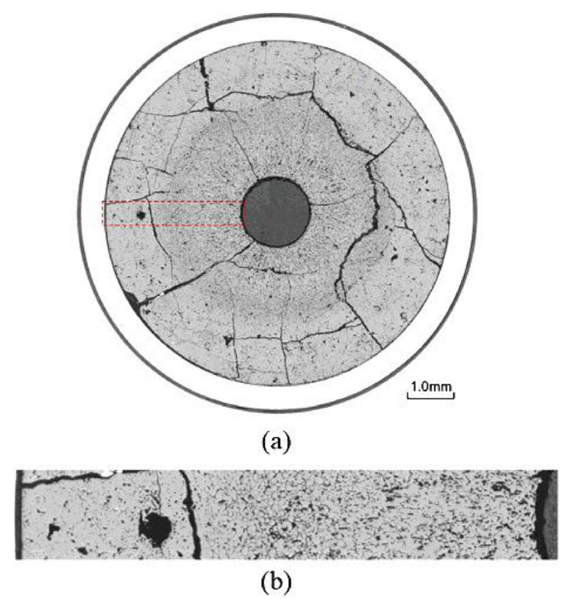
MOX Fuels in SFRs
SRFs with MOX fuel will lead the MOX to run at higher temperatures than LWR fuel, and thus with different properties
Fission product phases and evolving microstructures create highly localized properties that can differ significantly from the bulk fuel
Stoichiometry and Pu content are important factors that dictate thermal properties

Slide 23
MOX Restructuring
Oxide nuclear fuels are commonly touted for their outstanding high temperature capabilities under irradiation, but this stability comes the tradeoff of low thermal conductivity
Due to the low thermal transport, a steep temperature gradient is formed along the radius of the fuel pellet, with the hottest region at the center of the pellet and coolest near the cladding
This leads to grain growth and restructuring
Pu bearing fast reactor oxide fuels display four defining regions of a restructured pellet:
the central void, the columnar grain growth region, the equiaxed grain growth region, and the as-sintered region
The higher temperatures and heating rates form coarse, elongated grains that grow radially toward the outer rim of the fuel

Slide 24
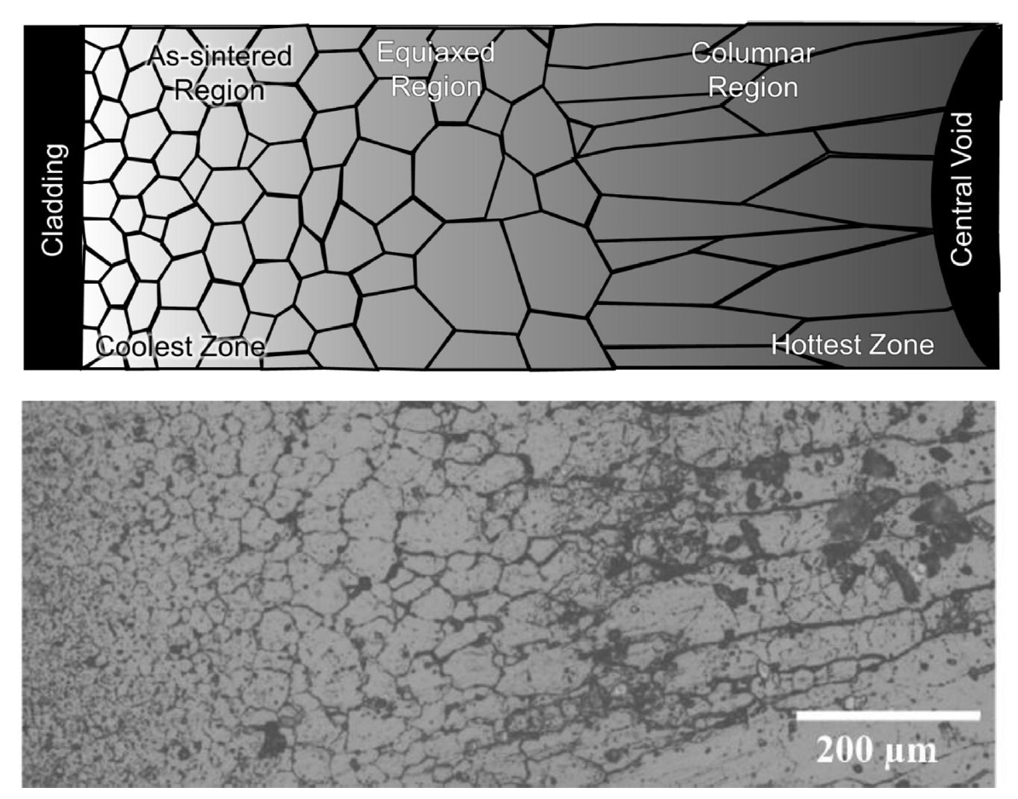
MOX Restructuring
The equiaxed region consists of grains that have undergone significant growth when compared to the un-irradiated samples
Central voids have been shown to appear in irradiation times as short as 10 min, demonstrating that the appearance the central void is a result of fuel temperature and linear heating rate, not high burnup
The central void forms from the accumulation of voids and pores present in the fuel along a thermal gradient

Slide 25
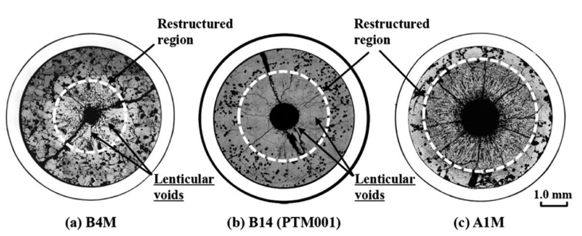
MOX Pore Formation
Heating Rate

Slide 26
MOX Pore Formation
The smallest spherical pores are highly mobile, being able to quickly and easily move through the restructured region
Intermediate sized pores become flat and elongated as they travel towards the fuel centers, leaving streaks at the tips of the voids as they travel
These “lenticular” voids are the most readily identifiable porosity feature in the irradiated MOX fuels due to their distinct shape

Slide 27
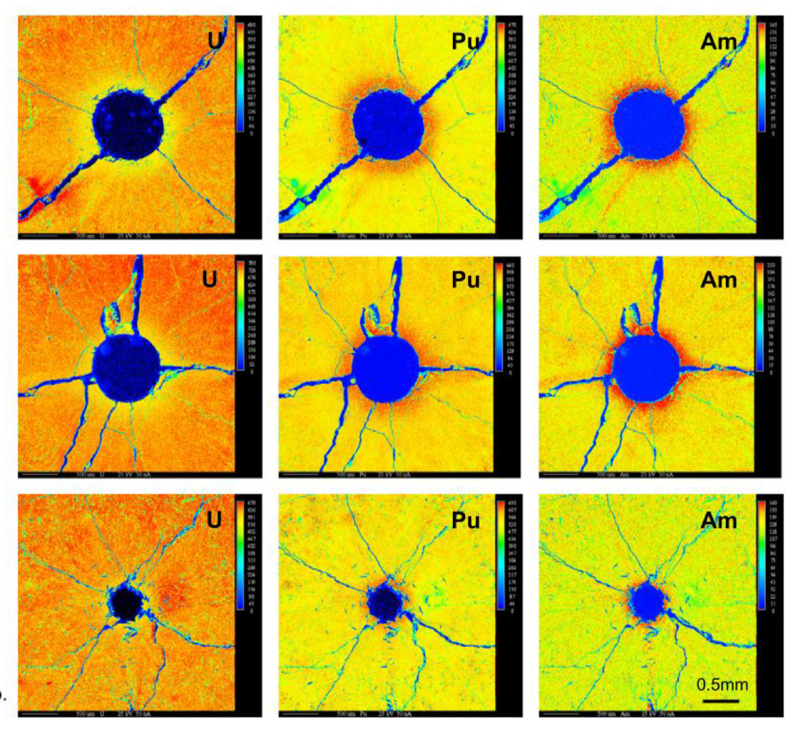
Redistribution of Pu
The movement of pores leads to a redistribution of plutonium, resulting in a spike in Pu concentration surrounding the central void
Similar behavior has been observed for americium
This transuranic concentration increase is accompanied with a decrease in U concentration
This redistribution increases the local fission rate and centerline temperature, while generating lower melting point phases

Slide 28
Redistribution of Pu
This phenomenon is currently understood as an evaporation-condensation process
The fuel at the edge of the pore closest to the centerline becomes gaseous inside the pore and deposits itself on the cooler region of the pore closest to the cladding
UO2 is the more volatile of the U/Pu heavy metal species present in the fuel matrix
The high oxygen potential can lead to a high partial pressure of UO3 within the self-contained pores
Enriched regions of PuO2 are left behind and deposited at the leading edge of the central void as the porosity agglomerates in the fuel center
Some experiments on O/M ratio seems to point towards higher O potential leading to more redistribution
While this is the working theory, it is not clear if this explanation can also account for the necessary pore velocities
No experimentally proven substitution has been put forth as a replacement theory to the observed features

Slide 29
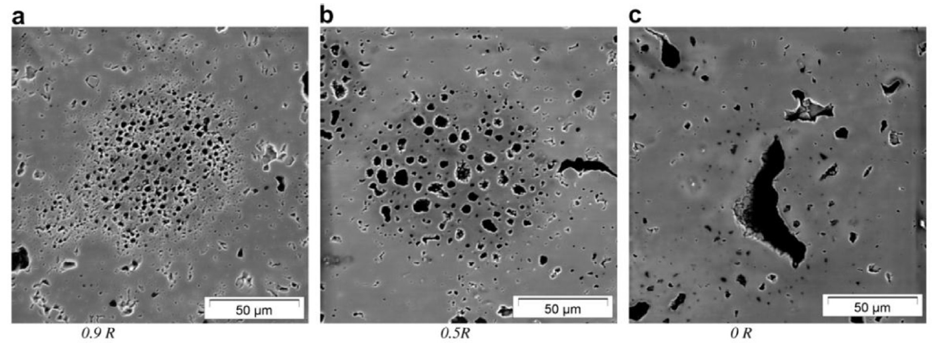
Pu-rich Agglomerates
Regions of high Pu concentration form in the MOX fuel matrix due to incomplete mixing during fabrication
Clusters of dispersed porosity form in the high Pu concentration regions because of the different fission rate
PA's are highly dense in fissile material, with the high Pu content leading to heating rates and burnups beyond the low concentration UO2 matrix material
Thermal conductivity of the spots is also lower than the surrounding matrix, thus the agglomerates are simultaneously hotter and undergo a greater number of fission events in a very small region
Burnup in these regions may be greater than 2-3 times that of the pellet as a whole

Slide 30
Pu-rich Agglomerates
The morphology of porosity in the agglomerates depends on the temperature
Toward the outer, relatively cool section of the fuel, porosity forms a large number of small bubbles, only 1-2 μm in diameter
In the intermediate radius of the pellet the densely populated, small pores start to agglomerate to form larger pores
Near the hot center of the fuel, the bubbles now reach sizes upwards of 50 μm with only a few isolated pores remaining
Porosity formed due to PA's are visually distinct from those caused by fission gas accumulation on grain boundaries and porosity formed during pellet sintering

Slide 31
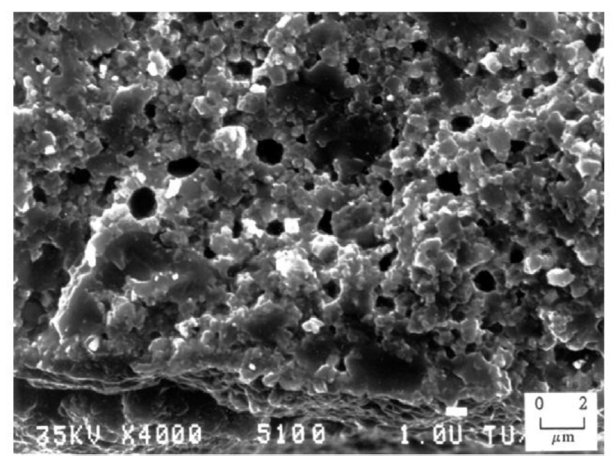
Pu-rich Agglomerates
The presence of the high burnup structure (HBS) has been observed within the PA regions
The HBS is basically a fine grained, cauliflower-like structure
In MOX fuels, the HBS structure appears in fuels following burnups between 60 and 80 GWd/tM at temperatures below approximately 1100C
PA's reach these local burnups at pellet burnups far below this threshold

Slide 32
Summary
Pyroprocessing
well established method relying on molten salt and anode deposition
Metallic fuel performance modeling
BISON, ALFUS, LIFEMETAL
all still currently require extensive assumptions
MOX intro
restructuring, Pu redistribution, Pu agglomerates

Slide 33
Questions?

